Slide 1


Enrichment Sessions
6 Week Series
15th Oct to 20th Nov 2021
#NEFUTURES
Healthcare Technology
Notes:
Imagine you’re getting your first pair of glasses. Your eyesight has been changing slowly – too slowly for you to really notice what’s happening – and then you put that first pair on, and suddenly reading the menu at a coffee shop or the whiteboard at school is easy. When you go outside, every leaf on every tree is sharp and in focus. You can see details around you that you hadn’t even known you were missing.
For a lot of businesses, last year was like that new pair of glasses. The pandemic was a moment of truth, forcing enterprises to look at themselves through a different lens. It tested businesses in unexpected ways, it raised the bar for how adaptable and how innovative they needed to be, and it revealed vulnerabilities they had largely been able to ignore before. From inflexible work arrangements, to fragile supply chains, to untrustworthy information, COVID-19 showed businesses the limitations of how they have been operating.
And in response, businesses across every industry have begun a journey to reinvention. They dramatically accelerated their digital transformation timelines, compressing plans for the next decade into the next two or three years. To keep employees working and meet rapidly changing customer needs, they pivoted faster than many previously thought they could.
In just a few weeks at the beginning of the pandemic, the UK’s National Health Service rolled Microsoft Teams out to 1.2 million employees.
When fewer customers could go for test drives, Ford created 10 interactive augmented reality videos for its new electric Mustang Mach-E, so people could get a true feel for the car remotely.
The Geisinger Health System accelerated its investments in API modernization and microservices, gaining the agility and scalability they needed to seamlessly move to remote visits, double their remote workforce, and build a digital screening system and dashboard to let administrators do things like view real-time patient population data, reduce waits, and ensure social distancing.
So, after a year of rapid transformation, what are we left with?

Slide 2
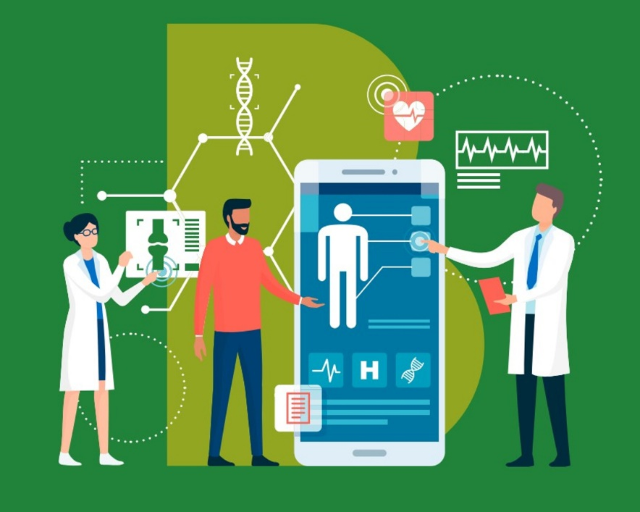



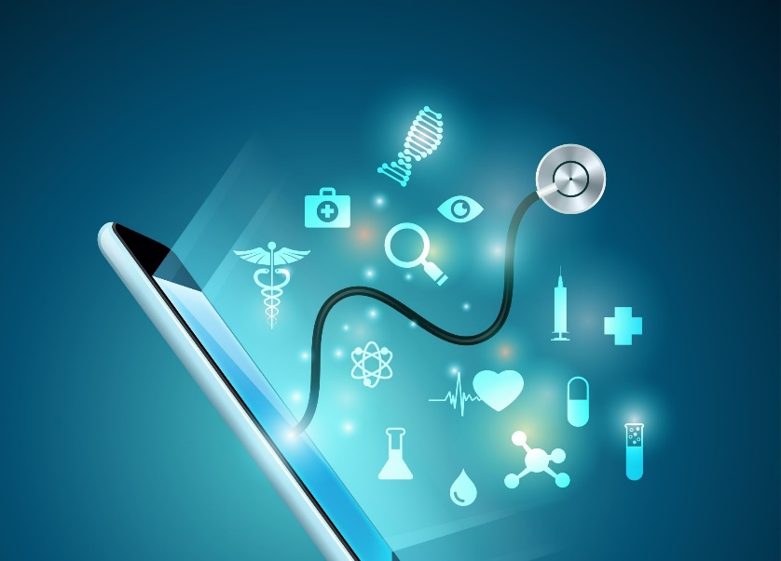
Overview:
Why Digital and Healthcare?
#NEFUTURES
This Enrichment programme aimed to identify the intersections between Healthcare Science and Digital Technology, particularly how technology can be utilised by healthcare professionals to improve patient care and outcomes.
Due to the excellent employment prospects in Digital Technology and Healthcare Science in the North East, the focus of North East Futures UTC is to introduce its students to these industries. As part of the curriculum, students are encouraged to explore the opportunities these specialisms provide and consider pursuing a career in one or both of these sectors.
Organisers:
Mark Larsen (Former Global Lead for Technology, Public Service
Accenture) and Dominic Hall designed the Healthcare Technology enrichment programme to be directed at students interested in both specialisms, allowing them to discover and understand the myriad overlaps between the two industries.
Dominic Hall
Healthcare Science Lead and Biology Teacher at North East Futures UTC
Mark Larsen
Former Global Lead for Technology, Public Service
Accenture
Notes:
Imagine you’re getting your first pair of glasses. Your eyesight has been changing slowly – too slowly for you to really notice what’s happening – and then you put that first pair on, and suddenly reading the menu at a coffee shop or the whiteboard at school is easy. When you go outside, every leaf on every tree is sharp and in focus. You can see details around you that you hadn’t even known you were missing.
For a lot of businesses, last year was like that new pair of glasses. The pandemic was a moment of truth, forcing enterprises to look at themselves through a different lens. It tested businesses in unexpected ways, it raised the bar for how adaptable and how innovative they needed to be, and it revealed vulnerabilities they had largely been able to ignore before. From inflexible work arrangements, to fragile supply chains, to untrustworthy information, COVID-19 showed businesses the limitations of how they have been operating.
And in response, businesses across every industry have begun a journey to reinvention. They dramatically accelerated their digital transformation timelines, compressing plans for the next decade into the next two or three years. To keep employees working and meet rapidly changing customer needs, they pivoted faster than many previously thought they could.
In just a few weeks at the beginning of the pandemic, the UK’s National Health Service rolled Microsoft Teams out to 1.2 million employees.
When fewer customers could go for test drives, Ford created 10 interactive augmented reality videos for its new electric Mustang Mach-E, so people could get a true feel for the car remotely.
The Geisinger Health System accelerated its investments in API modernization and microservices, gaining the agility and scalability they needed to seamlessly move to remote visits, double their remote workforce, and build a digital screening system and dashboard to let administrators do things like view real-time patient population data, reduce waits, and ensure social distancing.
So, after a year of rapid transformation, what are we left with?

Slide 3




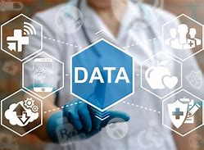


Health Technology Enrichment
#NEFUTURES
Overview
Challenges
Insight and Innovation
Industry Speakers
Interactive
6 sessions
6 Topics
Innovation
Data
Genomics
Convergence
Notes:
Being able to gather, visualize, and act on real-time information about facilities or processes is one of the greatest benefits of intelligent twins. It can help businesses optimize their operations, it can make it safer to increase autonomy, and more. But analyzing real-time data at this scale and speed is a challenge – it’s not uncommon for enterprises to invest in the IoT devices and sensors they need, but then struggle to fully utilize all the data those devices generate. Luckily, cloud-based services and platforms are emerging that can help bridge the gap. Snowflake, for instance, offers data warehousing as a service, which can load continuously generated real-time data, can digest semi-structured data, and requires no manual effort.
Trend: Mirrored World
Topics: data, IoT, cloud, software & platforms, North America
Source:
https://www.snowflake.com/

Slide 4
Enrichment Session
Wed 15th September, 2021
#NEFUTURES
Week 1 - Overview
Notes:
Imagine you’re getting your first pair of glasses. Your eyesight has been changing slowly – too slowly for you to really notice what’s happening – and then you put that first pair on, and suddenly reading the menu at a coffee shop or the whiteboard at school is easy. When you go outside, every leaf on every tree is sharp and in focus. You can see details around you that you hadn’t even known you were missing.
For a lot of businesses, last year was like that new pair of glasses. The pandemic was a moment of truth, forcing enterprises to look at themselves through a different lens. It tested businesses in unexpected ways, it raised the bar for how adaptable and how innovative they needed to be, and it revealed vulnerabilities they had largely been able to ignore before. From inflexible work arrangements, to fragile supply chains, to untrustworthy information, COVID-19 showed businesses the limitations of how they have been operating.
And in response, businesses across every industry have begun a journey to reinvention. They dramatically accelerated their digital transformation timelines, compressing plans for the next decade into the next two or three years. To keep employees working and meet rapidly changing customer needs, they pivoted faster than many previously thought they could.
In just a few weeks at the beginning of the pandemic, the UK’s National Health Service rolled Microsoft Teams out to 1.2 million employees.
When fewer customers could go for test drives, Ford created 10 interactive augmented reality videos for its new electric Mustang Mach-E, so people could get a true feel for the car remotely.
The Geisinger Health System accelerated its investments in API modernization and microservices, gaining the agility and scalability they needed to seamlessly move to remote visits, double their remote workforce, and build a digital screening system and dashboard to let administrators do things like view real-time patient population data, reduce waits, and ensure social distancing.
So, after a year of rapid transformation, what are we left with?

Slide 5


Theme: Overview
Content:
#NEFUTURES
What are the common choices faced when accessing healthcare in the UK? What paths can people take? How is technology used to help clinicians and improve the quality of care received?
Patient develops symptoms
Patient attends hospital
Patient is treated
Patient is diagnosed
Guest Speakers:
Acceleration of Technology due to the Pandemic
James Freed
Chief Information Officer at Health Education England
Telemedicine
Smartphone Apps
Sensors and wearables for diagnostics & remote monitoring
Speech recognition
Virtual and augmented reality
AI Image interpretation
AI predictive analytics
Reading the genome
Writing the genome
Dr. Rhys Wenlock
Junior Doctor
Junior Doctor
Notes:
Imagine you’re getting your first pair of glasses. Your eyesight has been changing slowly – too slowly for you to really notice what’s happening – and then you put that first pair on, and suddenly reading the menu at a coffee shop or the whiteboard at school is easy. When you go outside, every leaf on every tree is sharp and in focus. You can see details around you that you hadn’t even known you were missing.
For a lot of businesses, last year was like that new pair of glasses. The pandemic was a moment of truth, forcing enterprises to look at themselves through a different lens. It tested businesses in unexpected ways, it raised the bar for how adaptable and how innovative they needed to be, and it revealed vulnerabilities they had largely been able to ignore before. From inflexible work arrangements, to fragile supply chains, to untrustworthy information, COVID-19 showed businesses the limitations of how they have been operating.
And in response, businesses across every industry have begun a journey to reinvention. They dramatically accelerated their digital transformation timelines, compressing plans for the next decade into the next two or three years. To keep employees working and meet rapidly changing customer needs, they pivoted faster than many previously thought they could.
In just a few weeks at the beginning of the pandemic, the UK’s National Health Service rolled Microsoft Teams out to 1.2 million employees.
When fewer customers could go for test drives, Ford created 10 interactive augmented reality videos for its new electric Mustang Mach-E, so people could get a true feel for the car remotely.
The Geisinger Health System accelerated its investments in API modernization and microservices, gaining the agility and scalability they needed to seamlessly move to remote visits, double their remote workforce, and build a digital screening system and dashboard to let administrators do things like view real-time patient population data, reduce waits, and ensure social distancing.
So, after a year of rapid transformation, what are we left with?

Slide 6
Enrichment Session
Wed 22nd September, 2021
#NEFUTURES
Week 2 - Challenges
Notes:
Imagine you’re getting your first pair of glasses. Your eyesight has been changing slowly – too slowly for you to really notice what’s happening – and then you put that first pair on, and suddenly reading the menu at a coffee shop or the whiteboard at school is easy. When you go outside, every leaf on every tree is sharp and in focus. You can see details around you that you hadn’t even known you were missing.
For a lot of businesses, last year was like that new pair of glasses. The pandemic was a moment of truth, forcing enterprises to look at themselves through a different lens. It tested businesses in unexpected ways, it raised the bar for how adaptable and how innovative they needed to be, and it revealed vulnerabilities they had largely been able to ignore before. From inflexible work arrangements, to fragile supply chains, to untrustworthy information, COVID-19 showed businesses the limitations of how they have been operating.
And in response, businesses across every industry have begun a journey to reinvention. They dramatically accelerated their digital transformation timelines, compressing plans for the next decade into the next two or three years. To keep employees working and meet rapidly changing customer needs, they pivoted faster than many previously thought they could.
In just a few weeks at the beginning of the pandemic, the UK’s National Health Service rolled Microsoft Teams out to 1.2 million employees.
When fewer customers could go for test drives, Ford created 10 interactive augmented reality videos for its new electric Mustang Mach-E, so people could get a true feel for the car remotely.
The Geisinger Health System accelerated its investments in API modernization and microservices, gaining the agility and scalability they needed to seamlessly move to remote visits, double their remote workforce, and build a digital screening system and dashboard to let administrators do things like view real-time patient population data, reduce waits, and ensure social distancing.
So, after a year of rapid transformation, what are we left with?

Slide 7
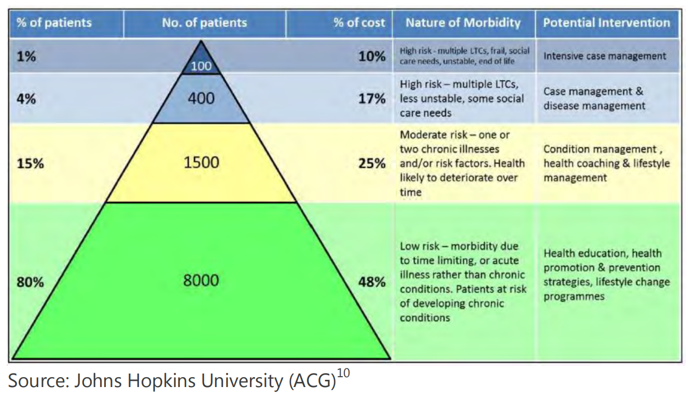

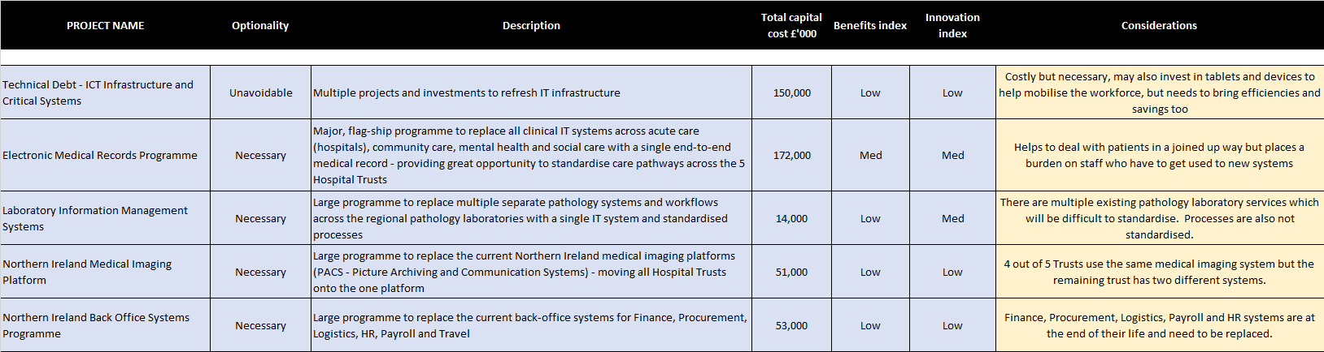
Theme: Challenges
Content:
#NEFUTURES
What are the challenges that the NHS faces? What factors determine priorities for investment? As a CDIO what choices would you make, and why?
The “Kaiser Pyramid”
Guest Speakers:
Dan West
Chief Digital Information Officer
Digital Health & Care Northern Ireland
Making ‘Real Life’ Choices over NHS IT Priorities
Notes:
Imagine you’re getting your first pair of glasses. Your eyesight has been changing slowly – too slowly for you to really notice what’s happening – and then you put that first pair on, and suddenly reading the menu at a coffee shop or the whiteboard at school is easy. When you go outside, every leaf on every tree is sharp and in focus. You can see details around you that you hadn’t even known you were missing.
For a lot of businesses, last year was like that new pair of glasses. The pandemic was a moment of truth, forcing enterprises to look at themselves through a different lens. It tested businesses in unexpected ways, it raised the bar for how adaptable and how innovative they needed to be, and it revealed vulnerabilities they had largely been able to ignore before. From inflexible work arrangements, to fragile supply chains, to untrustworthy information, COVID-19 showed businesses the limitations of how they have been operating.
And in response, businesses across every industry have begun a journey to reinvention. They dramatically accelerated their digital transformation timelines, compressing plans for the next decade into the next two or three years. To keep employees working and meet rapidly changing customer needs, they pivoted faster than many previously thought they could.
In just a few weeks at the beginning of the pandemic, the UK’s National Health Service rolled Microsoft Teams out to 1.2 million employees.
When fewer customers could go for test drives, Ford created 10 interactive augmented reality videos for its new electric Mustang Mach-E, so people could get a true feel for the car remotely.
The Geisinger Health System accelerated its investments in API modernization and microservices, gaining the agility and scalability they needed to seamlessly move to remote visits, double their remote workforce, and build a digital screening system and dashboard to let administrators do things like view real-time patient population data, reduce waits, and ensure social distancing.
So, after a year of rapid transformation, what are we left with?

Slide 8
Enrichment Session
Wed 29th September, 2021
#NEFUTURES
Week 3 - Innovation
Notes:
Imagine you’re getting your first pair of glasses. Your eyesight has been changing slowly – too slowly for you to really notice what’s happening – and then you put that first pair on, and suddenly reading the menu at a coffee shop or the whiteboard at school is easy. When you go outside, every leaf on every tree is sharp and in focus. You can see details around you that you hadn’t even known you were missing.
For a lot of businesses, last year was like that new pair of glasses. The pandemic was a moment of truth, forcing enterprises to look at themselves through a different lens. It tested businesses in unexpected ways, it raised the bar for how adaptable and how innovative they needed to be, and it revealed vulnerabilities they had largely been able to ignore before. From inflexible work arrangements, to fragile supply chains, to untrustworthy information, COVID-19 showed businesses the limitations of how they have been operating.
And in response, businesses across every industry have begun a journey to reinvention. They dramatically accelerated their digital transformation timelines, compressing plans for the next decade into the next two or three years. To keep employees working and meet rapidly changing customer needs, they pivoted faster than many previously thought they could.
In just a few weeks at the beginning of the pandemic, the UK’s National Health Service rolled Microsoft Teams out to 1.2 million employees.
When fewer customers could go for test drives, Ford created 10 interactive augmented reality videos for its new electric Mustang Mach-E, so people could get a true feel for the car remotely.
The Geisinger Health System accelerated its investments in API modernization and microservices, gaining the agility and scalability they needed to seamlessly move to remote visits, double their remote workforce, and build a digital screening system and dashboard to let administrators do things like view real-time patient population data, reduce waits, and ensure social distancing.
So, after a year of rapid transformation, what are we left with?

Slide 9
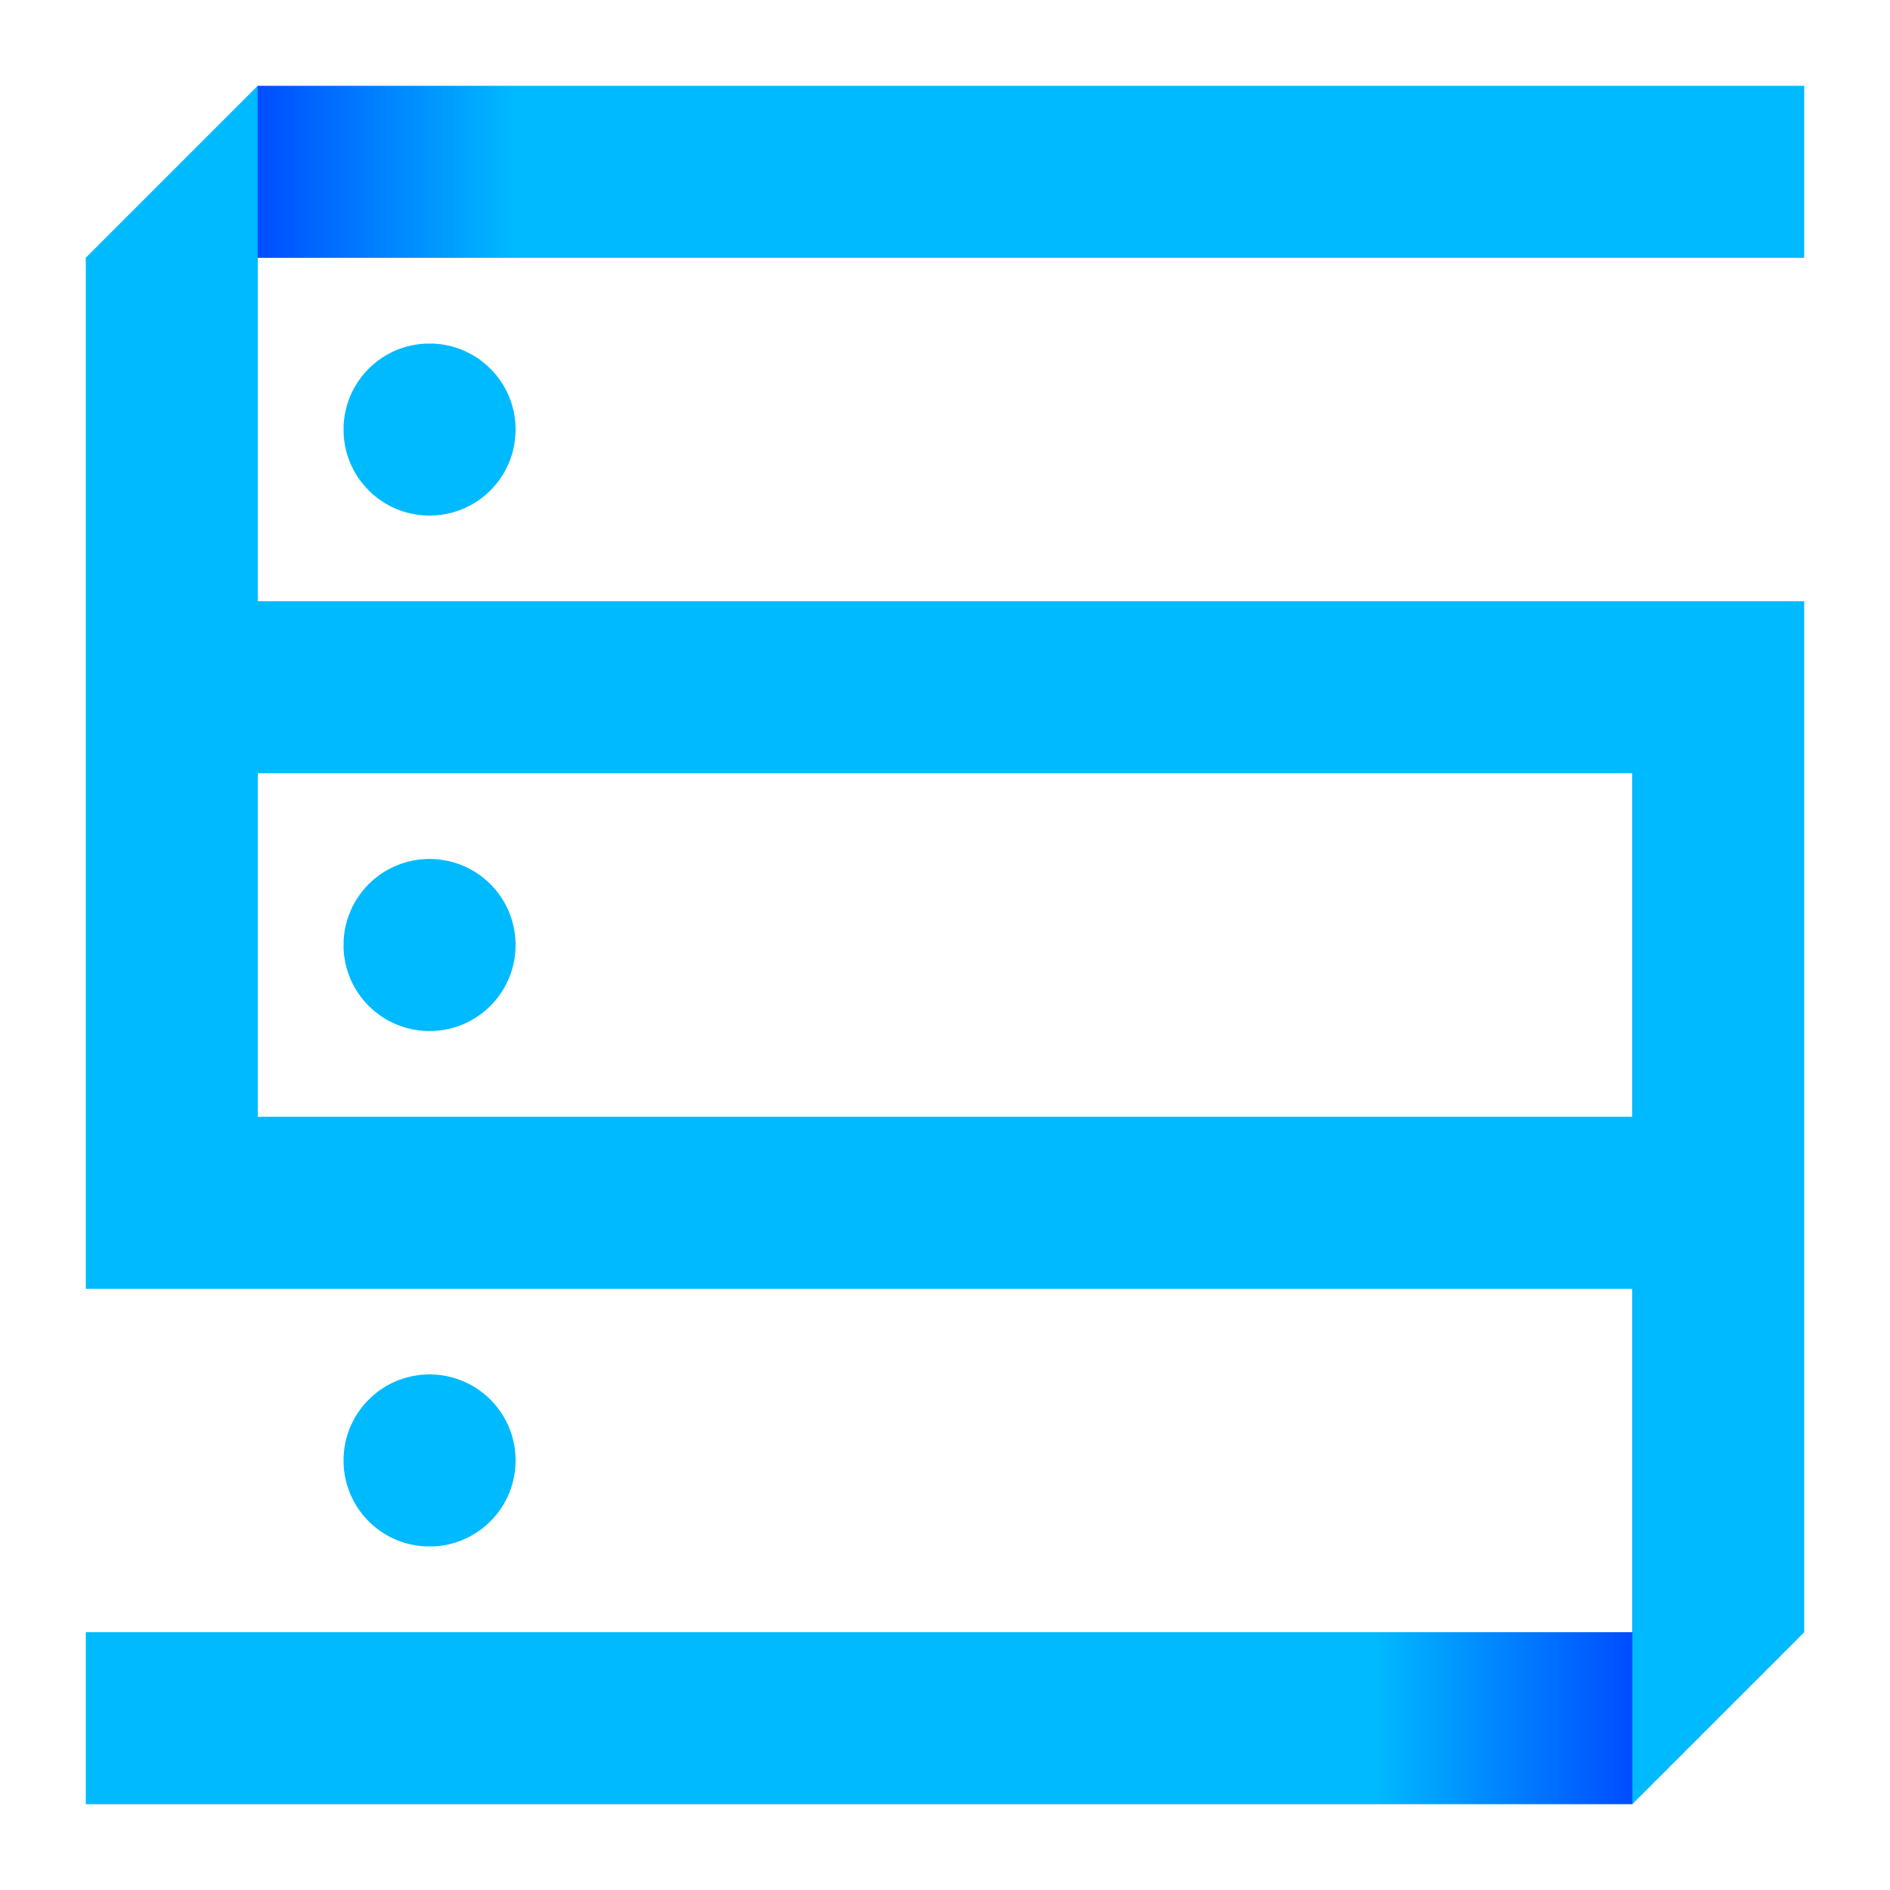
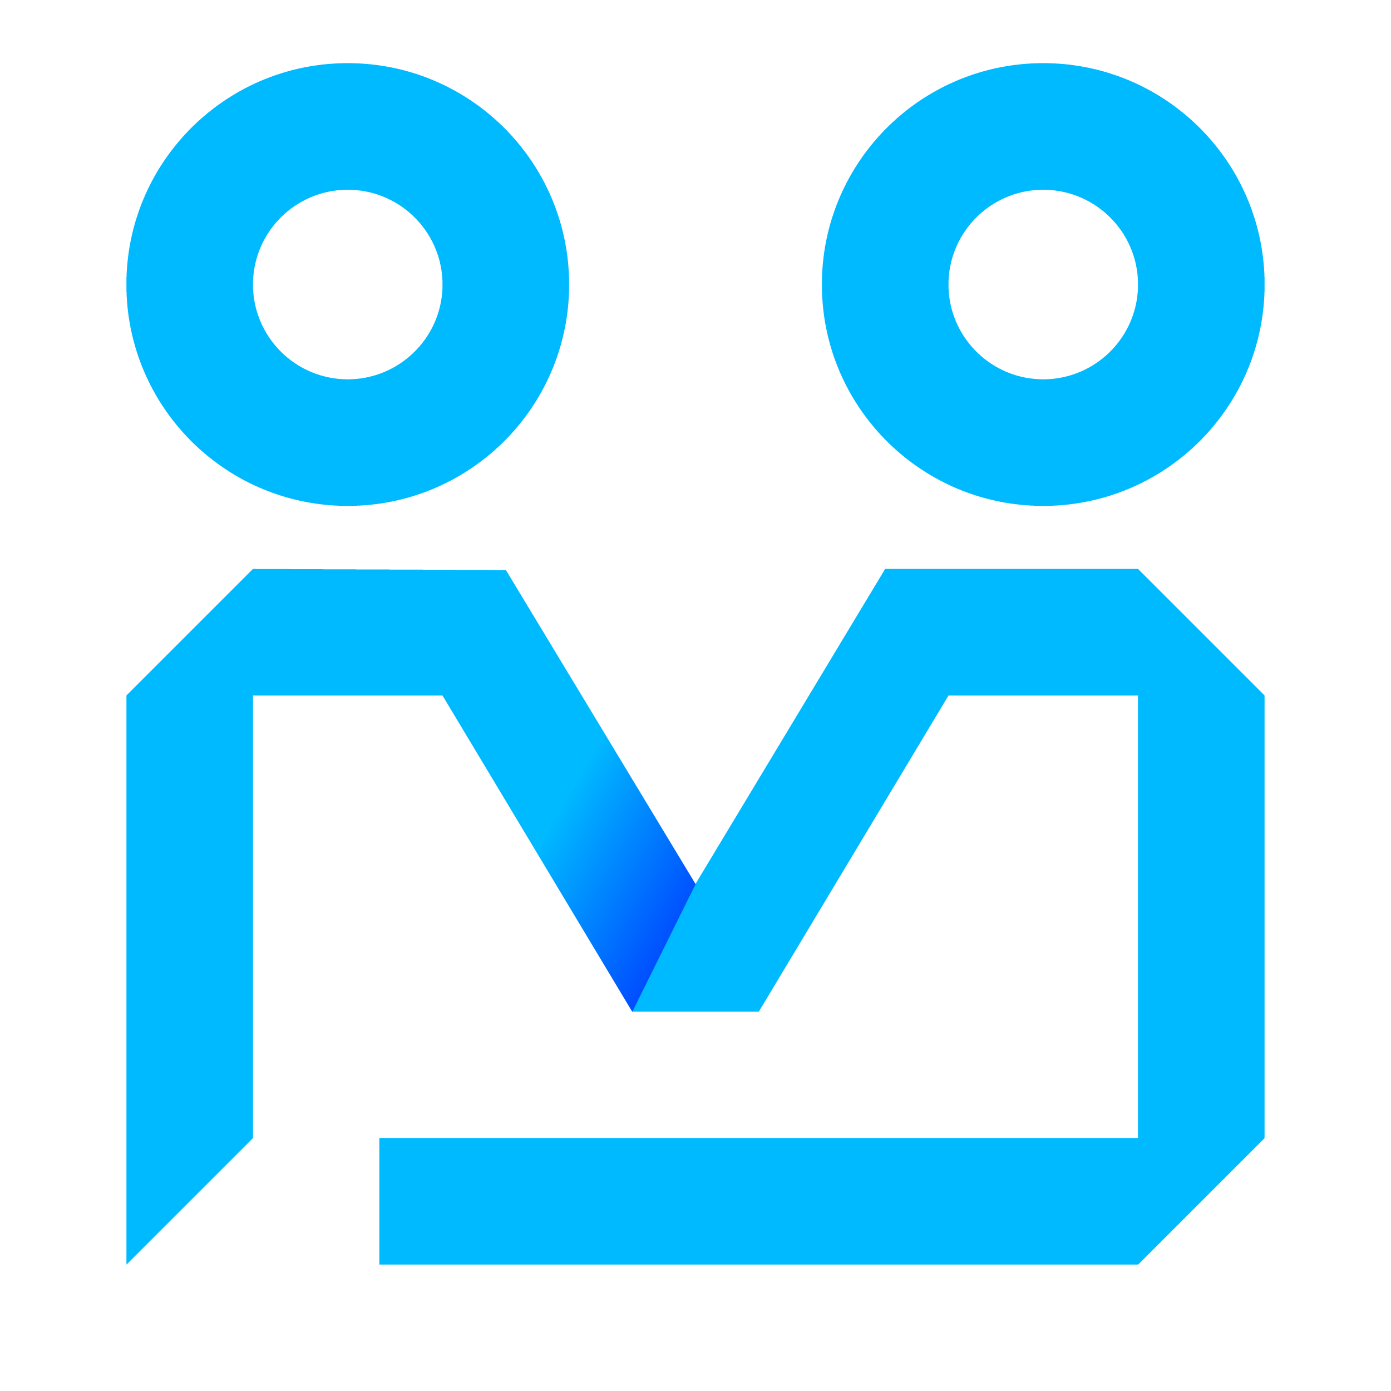
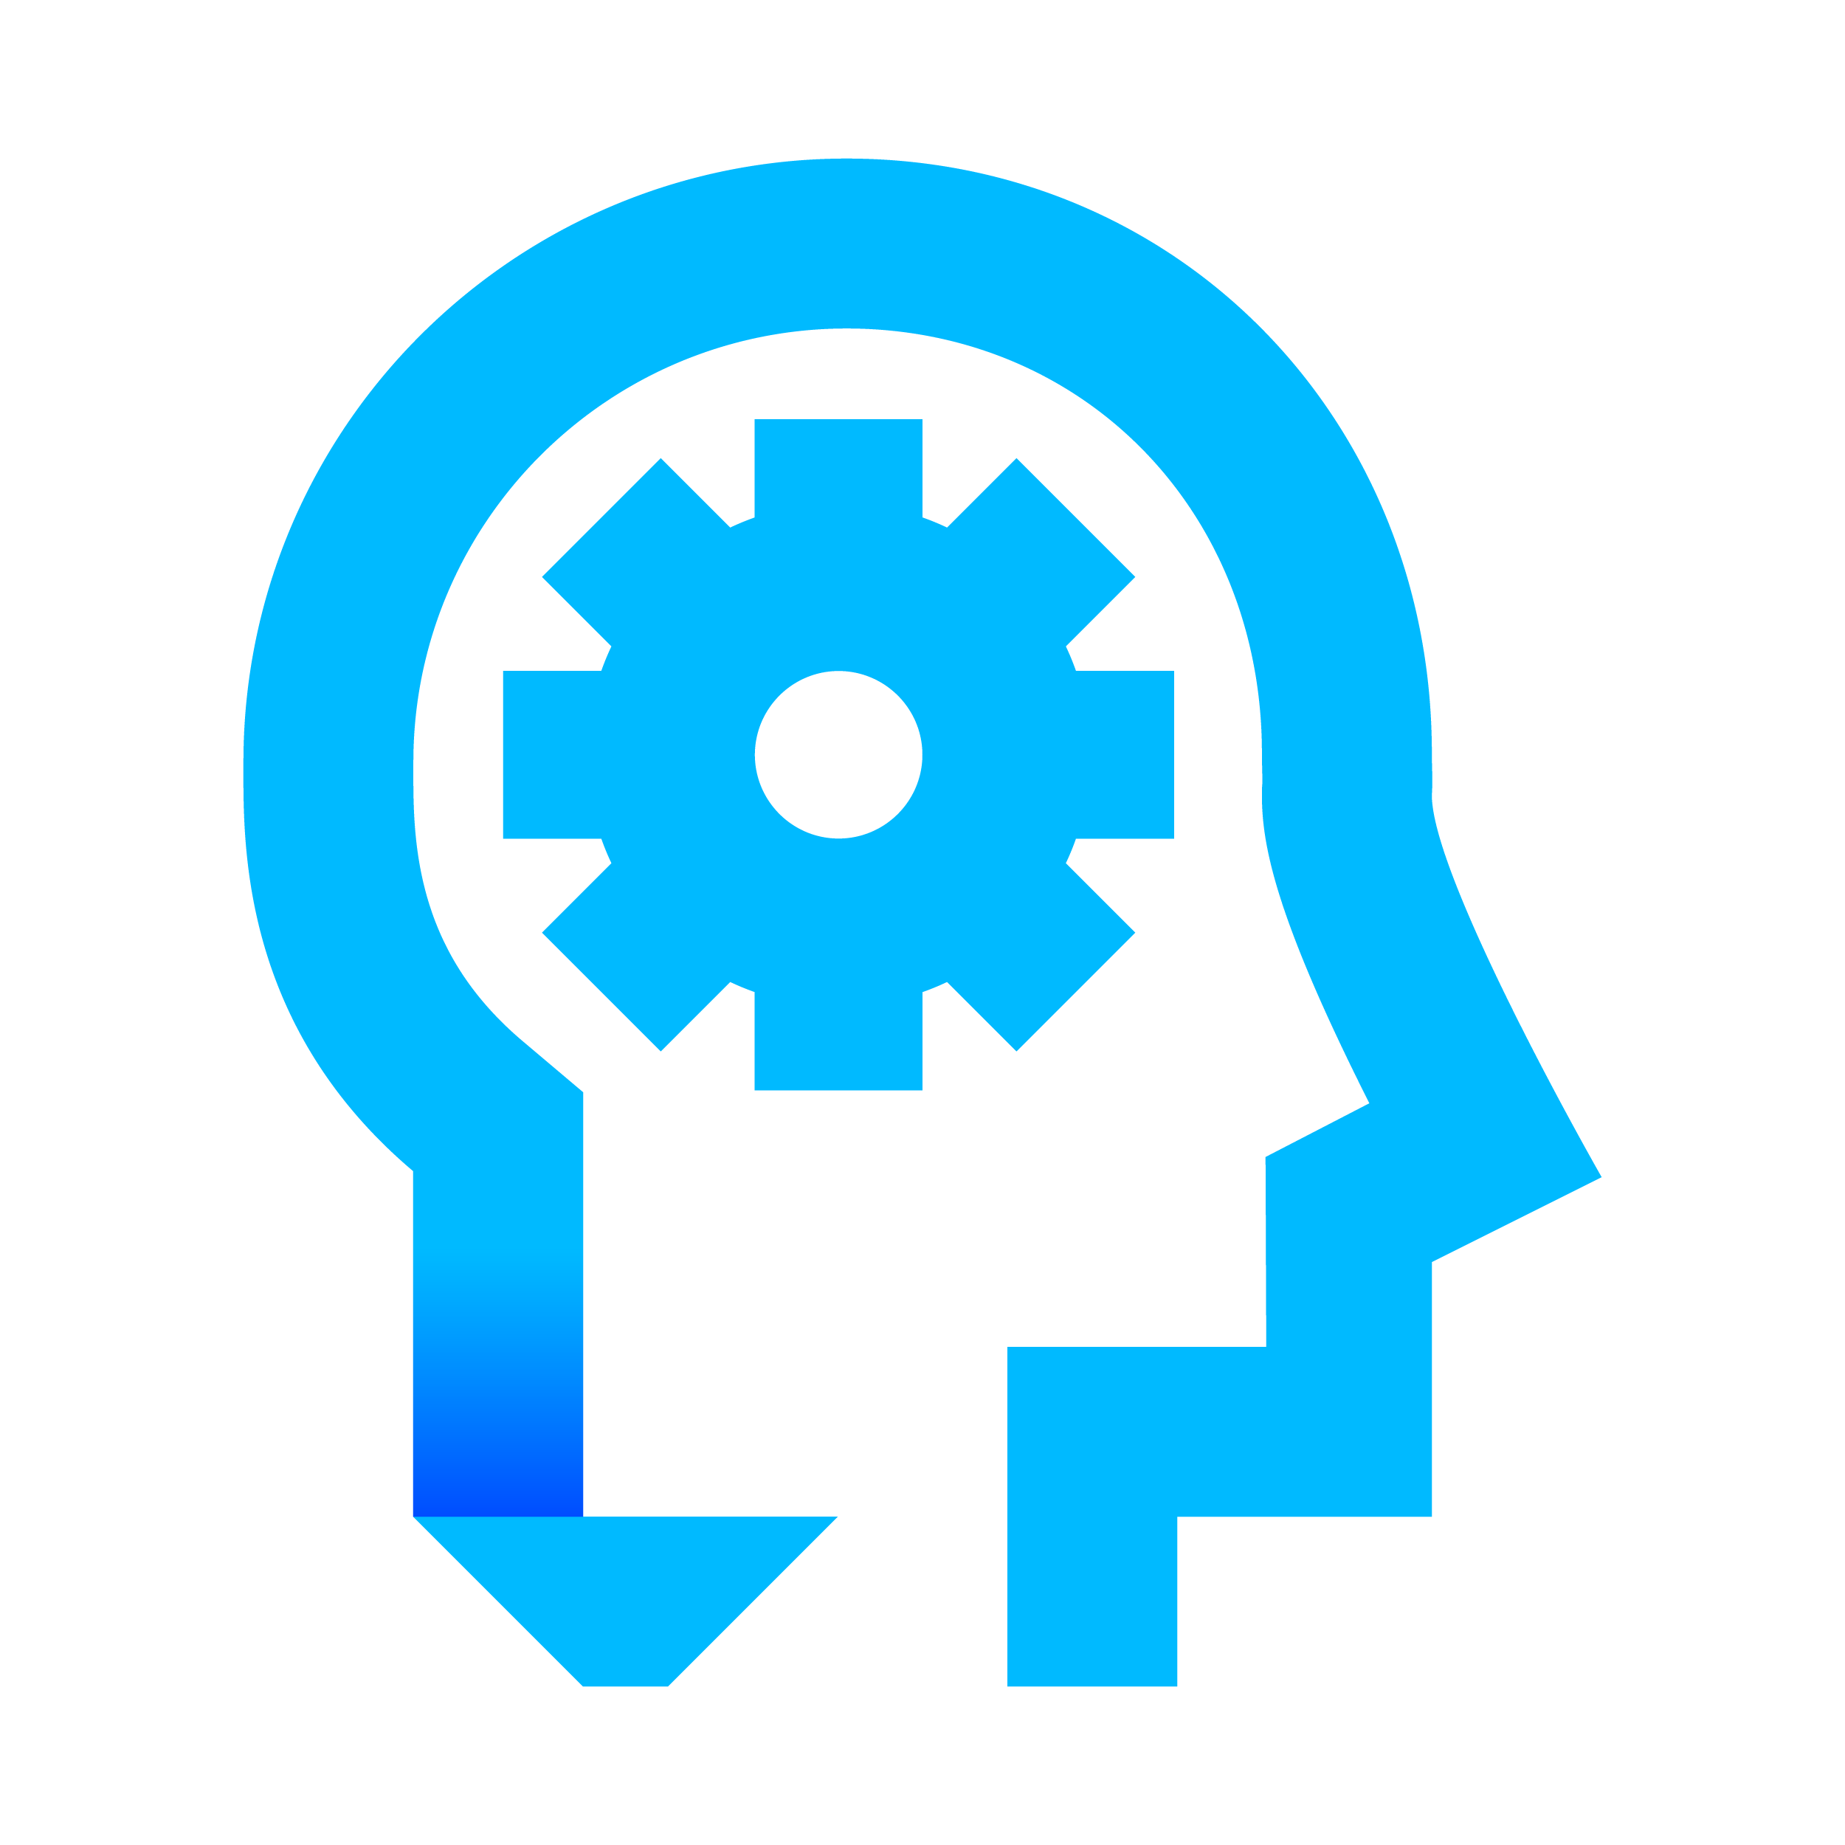
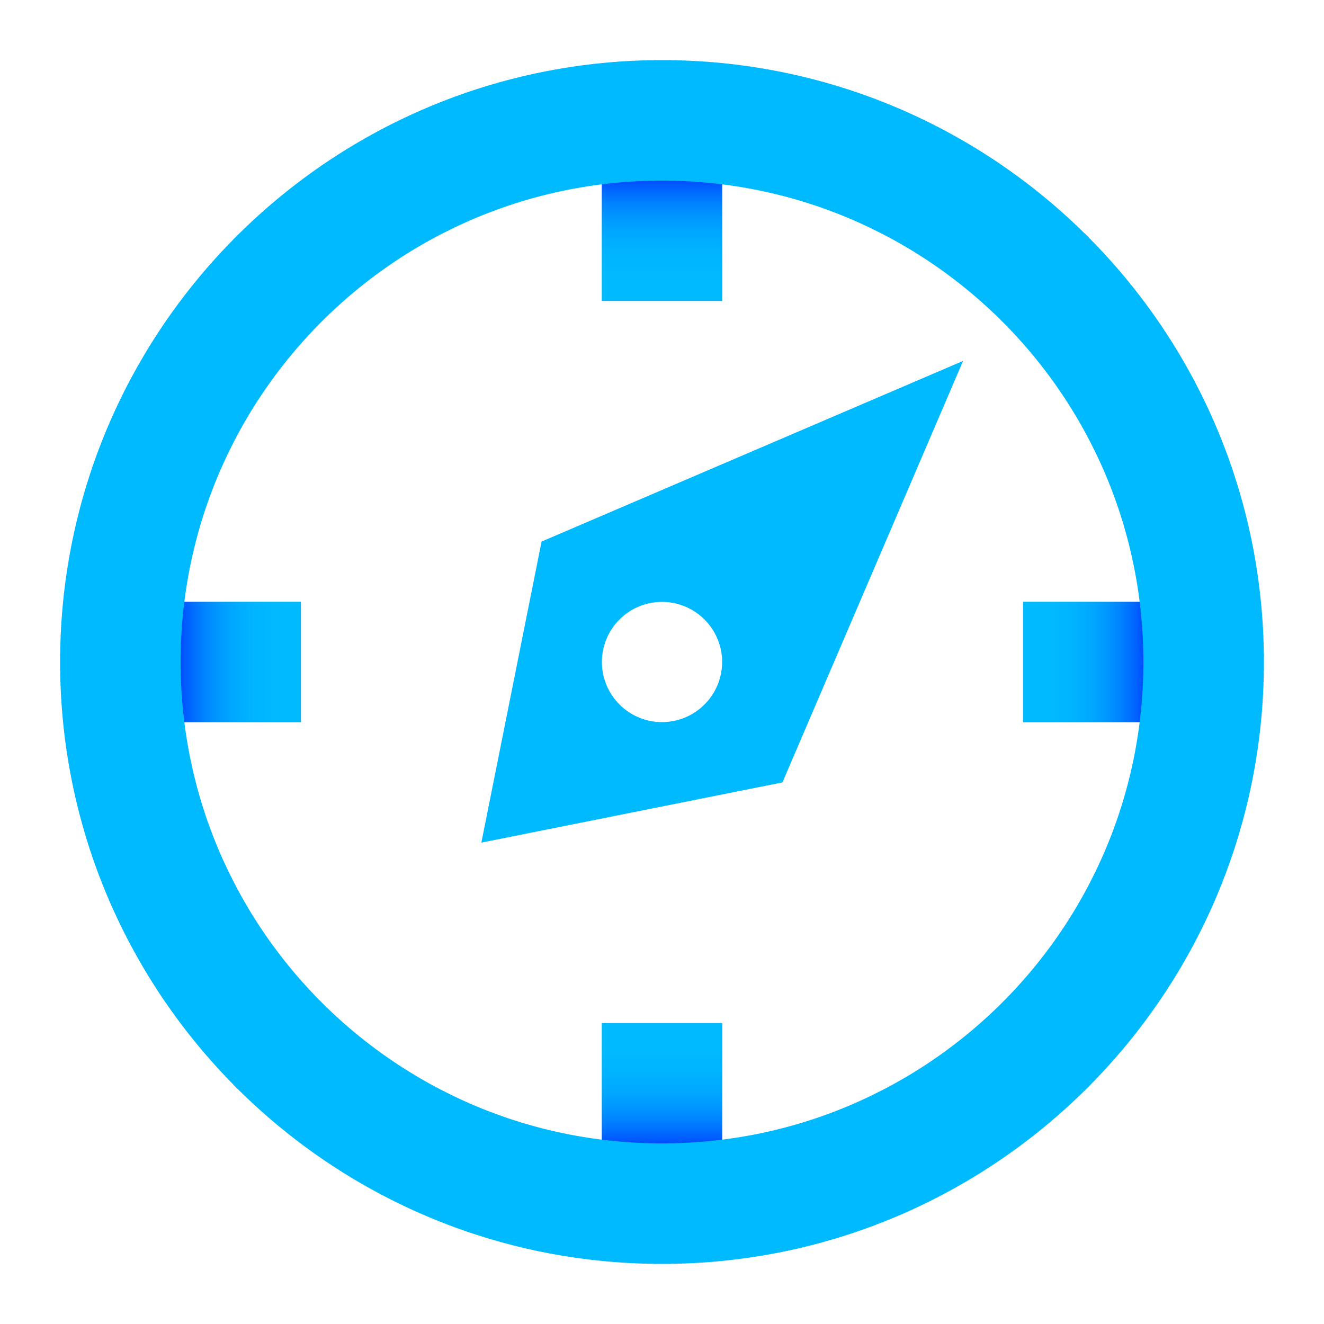
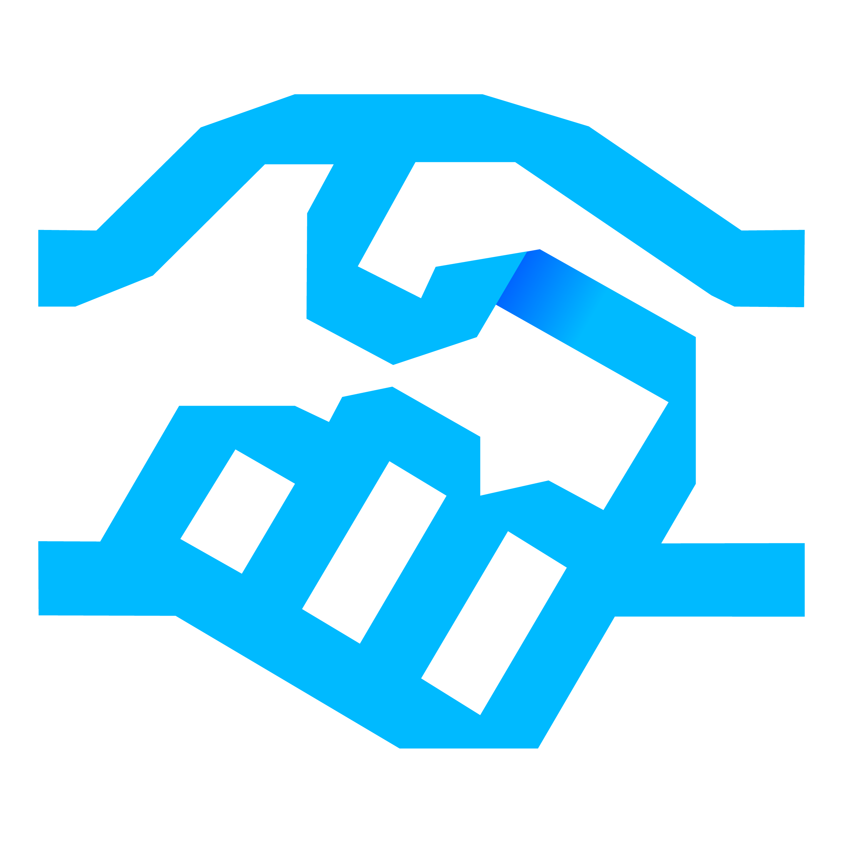

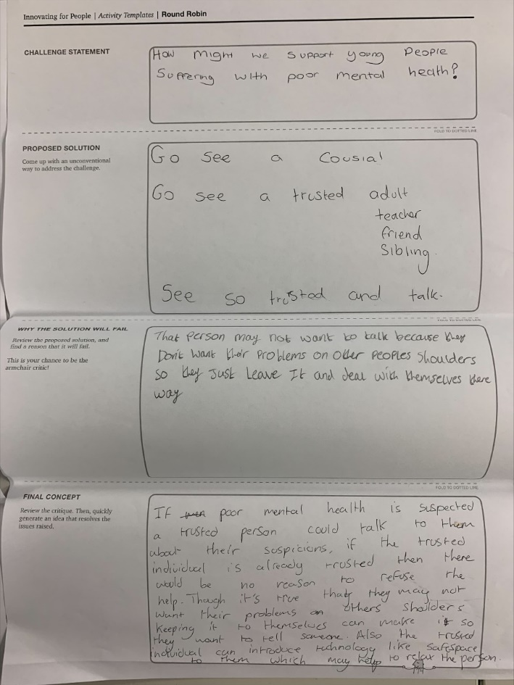
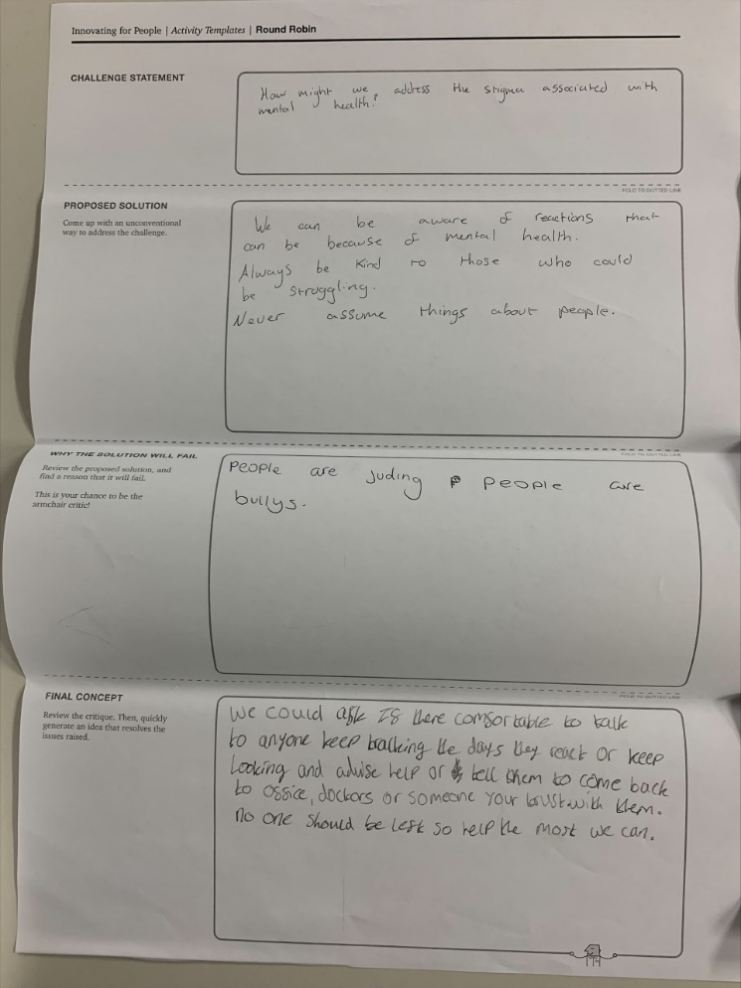

Theme: Innovation
Content:
#NEFUTURES
What are the current technology themes and trends? How could they be applied to Healthcare challenges? What are your innovation ideas?
Accenture Technology Vision 2021
Stack Strategically – flexible, reusable applications
Mirrored World – e.g. using ‘Digital Twins’
I, Technologist – teaching everyone to be an innovator
Anywhere, Everywhere – moving work to the people
Guest Speakers:
From Me to We – helping teams collaborate
Erin Kinnee
Design Thinking Lead – Accenture Advanced Technology Centre Newcastle
Innovation Ideas:
Roger Leaver
Innovation Programme Manager
Accenture Advanced Technology Centre Newcastle
Notes:
Imagine you’re getting your first pair of glasses. Your eyesight has been changing slowly – too slowly for you to really notice what’s happening – and then you put that first pair on, and suddenly reading the menu at a coffee shop or the whiteboard at school is easy. When you go outside, every leaf on every tree is sharp and in focus. You can see details around you that you hadn’t even known you were missing.
For a lot of businesses, last year was like that new pair of glasses. The pandemic was a moment of truth, forcing enterprises to look at themselves through a different lens. It tested businesses in unexpected ways, it raised the bar for how adaptable and how innovative they needed to be, and it revealed vulnerabilities they had largely been able to ignore before. From inflexible work arrangements, to fragile supply chains, to untrustworthy information, COVID-19 showed businesses the limitations of how they have been operating.
And in response, businesses across every industry have begun a journey to reinvention. They dramatically accelerated their digital transformation timelines, compressing plans for the next decade into the next two or three years. To keep employees working and meet rapidly changing customer needs, they pivoted faster than many previously thought they could.
In just a few weeks at the beginning of the pandemic, the UK’s National Health Service rolled Microsoft Teams out to 1.2 million employees.
When fewer customers could go for test drives, Ford created 10 interactive augmented reality videos for its new electric Mustang Mach-E, so people could get a true feel for the car remotely.
The Geisinger Health System accelerated its investments in API modernization and microservices, gaining the agility and scalability they needed to seamlessly move to remote visits, double their remote workforce, and build a digital screening system and dashboard to let administrators do things like view real-time patient population data, reduce waits, and ensure social distancing.
So, after a year of rapid transformation, what are we left with?

Slide 10
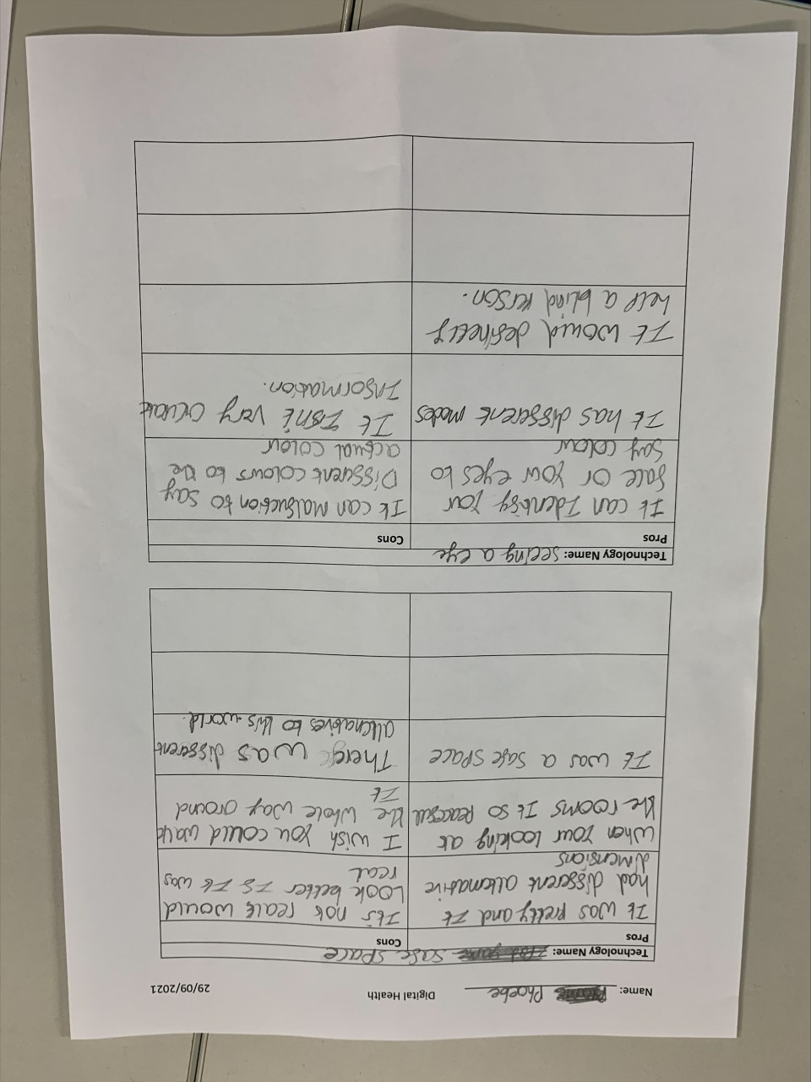
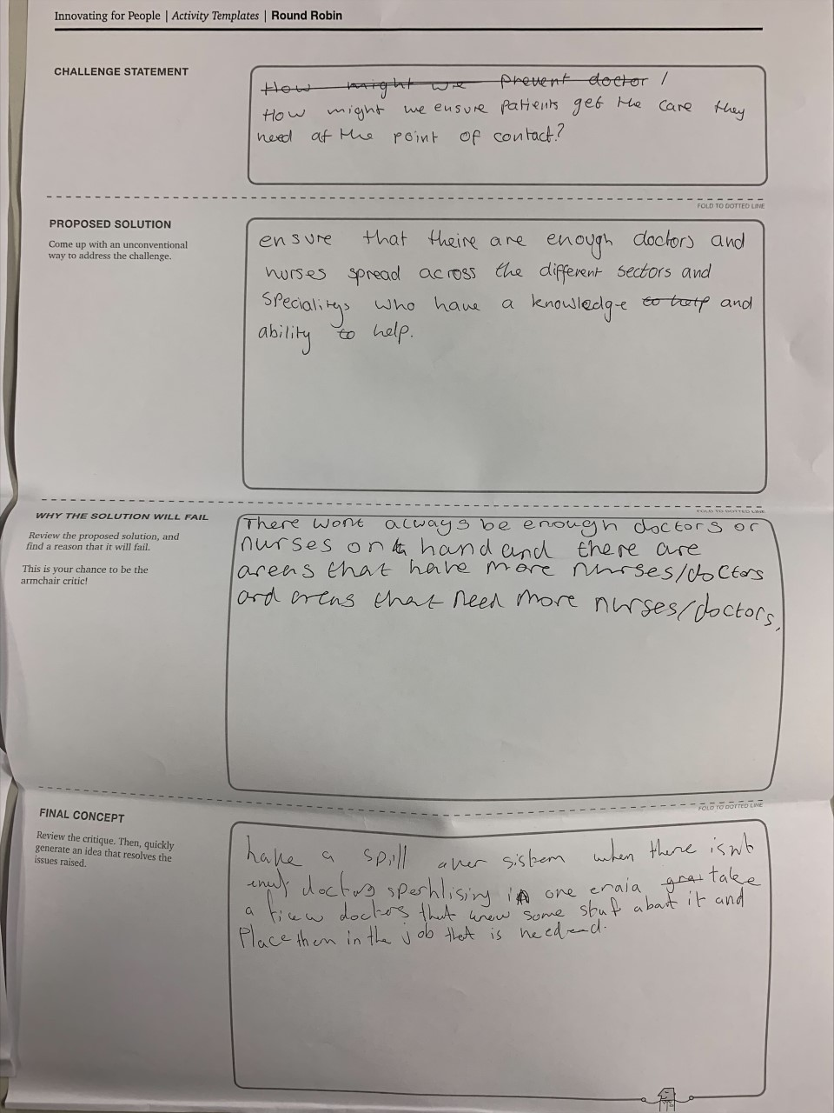
Student work

Slide 11
Enrichment Session
Wed 6th October, 2021
#NEFUTURES
Week 4 - Data
Notes:
Imagine you’re getting your first pair of glasses. Your eyesight has been changing slowly – too slowly for you to really notice what’s happening – and then you put that first pair on, and suddenly reading the menu at a coffee shop or the whiteboard at school is easy. When you go outside, every leaf on every tree is sharp and in focus. You can see details around you that you hadn’t even known you were missing.
For a lot of businesses, last year was like that new pair of glasses. The pandemic was a moment of truth, forcing enterprises to look at themselves through a different lens. It tested businesses in unexpected ways, it raised the bar for how adaptable and how innovative they needed to be, and it revealed vulnerabilities they had largely been able to ignore before. From inflexible work arrangements, to fragile supply chains, to untrustworthy information, COVID-19 showed businesses the limitations of how they have been operating.
And in response, businesses across every industry have begun a journey to reinvention. They dramatically accelerated their digital transformation timelines, compressing plans for the next decade into the next two or three years. To keep employees working and meet rapidly changing customer needs, they pivoted faster than many previously thought they could.
In just a few weeks at the beginning of the pandemic, the UK’s National Health Service rolled Microsoft Teams out to 1.2 million employees.
When fewer customers could go for test drives, Ford created 10 interactive augmented reality videos for its new electric Mustang Mach-E, so people could get a true feel for the car remotely.
The Geisinger Health System accelerated its investments in API modernization and microservices, gaining the agility and scalability they needed to seamlessly move to remote visits, double their remote workforce, and build a digital screening system and dashboard to let administrators do things like view real-time patient population data, reduce waits, and ensure social distancing.
So, after a year of rapid transformation, what are we left with?

Slide 12

Theme: Data
Content:
#NEFUTURES
What data does the NHS use and collect? Why is it important? What data would you use to improve the quality of care? What are the risks of using data?
NHS Resolution
Value of Data
Insight
Information
Data
Claims management
Practitioner Performance Advice
Primary Care Appeals
Safety and Learning
Guest Speakers:
Niamh McKenna
Chief Information Officer
NHS Resolution
Making ‘Real Life’ Choices over which Data to use
Notes:
Imagine you’re getting your first pair of glasses. Your eyesight has been changing slowly – too slowly for you to really notice what’s happening – and then you put that first pair on, and suddenly reading the menu at a coffee shop or the whiteboard at school is easy. When you go outside, every leaf on every tree is sharp and in focus. You can see details around you that you hadn’t even known you were missing.
For a lot of businesses, last year was like that new pair of glasses. The pandemic was a moment of truth, forcing enterprises to look at themselves through a different lens. It tested businesses in unexpected ways, it raised the bar for how adaptable and how innovative they needed to be, and it revealed vulnerabilities they had largely been able to ignore before. From inflexible work arrangements, to fragile supply chains, to untrustworthy information, COVID-19 showed businesses the limitations of how they have been operating.
And in response, businesses across every industry have begun a journey to reinvention. They dramatically accelerated their digital transformation timelines, compressing plans for the next decade into the next two or three years. To keep employees working and meet rapidly changing customer needs, they pivoted faster than many previously thought they could.
In just a few weeks at the beginning of the pandemic, the UK’s National Health Service rolled Microsoft Teams out to 1.2 million employees.
When fewer customers could go for test drives, Ford created 10 interactive augmented reality videos for its new electric Mustang Mach-E, so people could get a true feel for the car remotely.
The Geisinger Health System accelerated its investments in API modernization and microservices, gaining the agility and scalability they needed to seamlessly move to remote visits, double their remote workforce, and build a digital screening system and dashboard to let administrators do things like view real-time patient population data, reduce waits, and ensure social distancing.
So, after a year of rapid transformation, what are we left with?

Slide 13
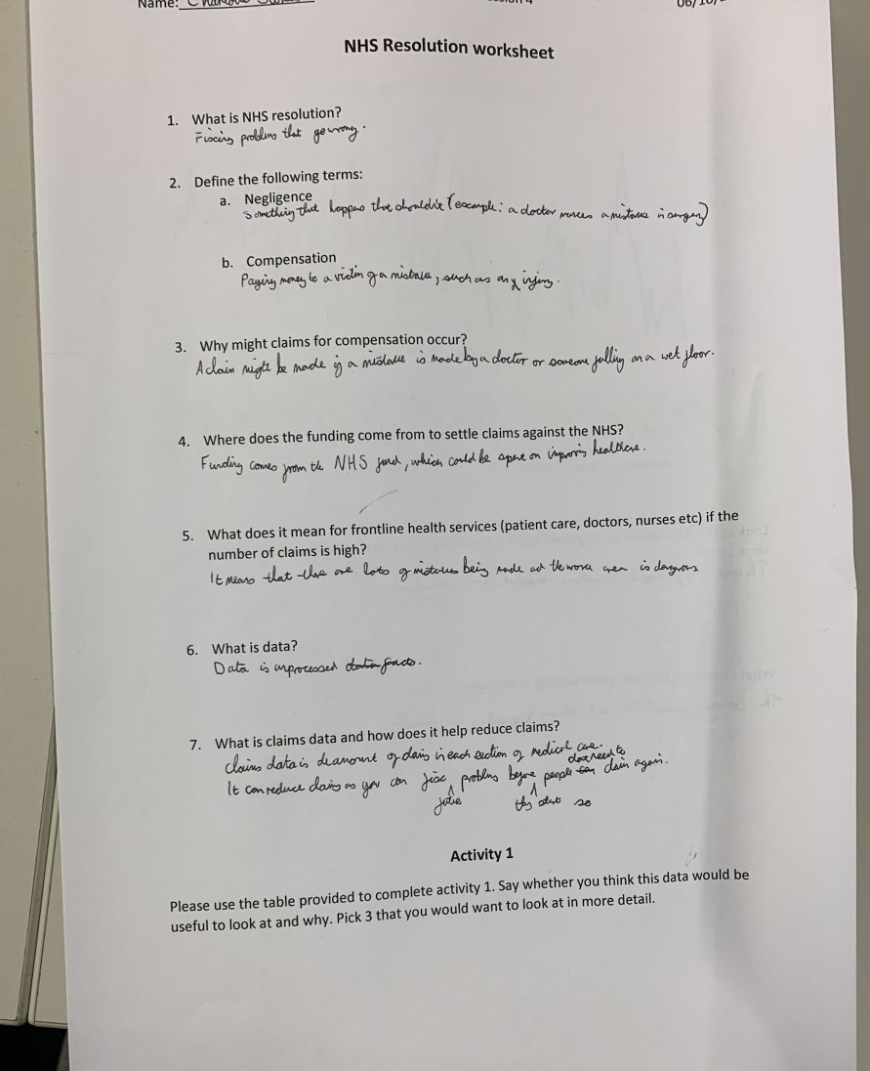
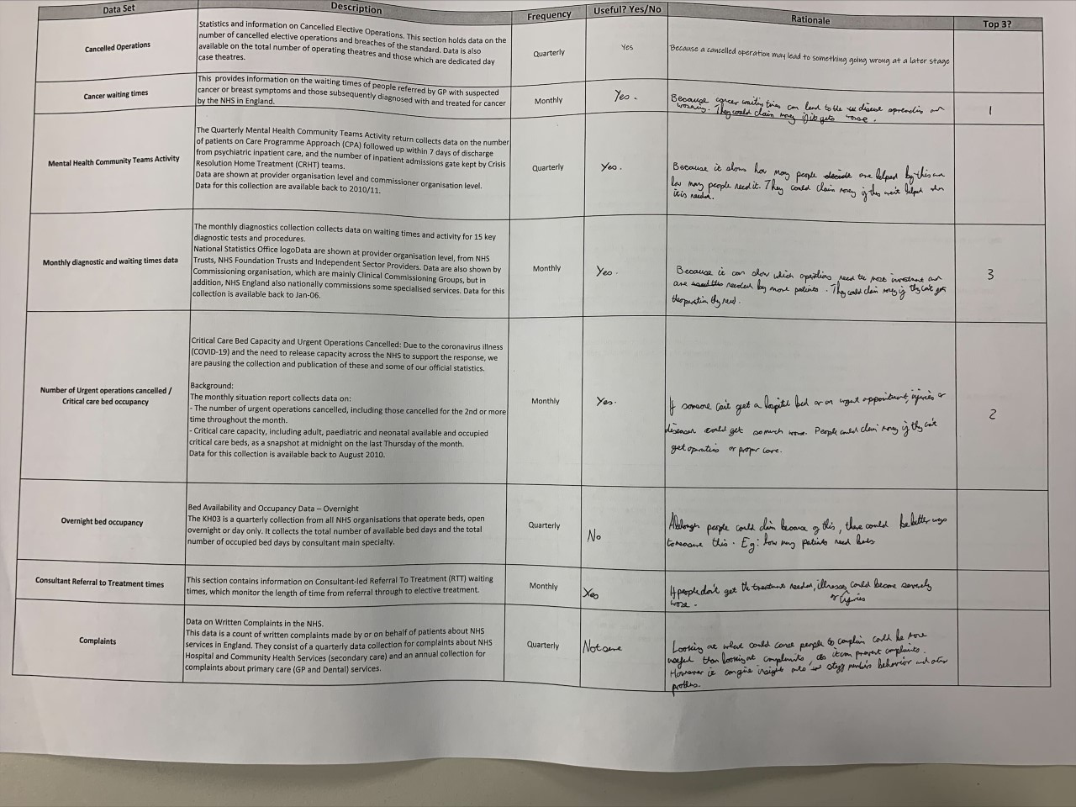
Student work

Slide 14
Enrichment Session
Wed 13th October, 2021
#NEFUTURES
Week 5 - Genomics
Notes:
Imagine you’re getting your first pair of glasses. Your eyesight has been changing slowly – too slowly for you to really notice what’s happening – and then you put that first pair on, and suddenly reading the menu at a coffee shop or the whiteboard at school is easy. When you go outside, every leaf on every tree is sharp and in focus. You can see details around you that you hadn’t even known you were missing.
For a lot of businesses, last year was like that new pair of glasses. The pandemic was a moment of truth, forcing enterprises to look at themselves through a different lens. It tested businesses in unexpected ways, it raised the bar for how adaptable and how innovative they needed to be, and it revealed vulnerabilities they had largely been able to ignore before. From inflexible work arrangements, to fragile supply chains, to untrustworthy information, COVID-19 showed businesses the limitations of how they have been operating.
And in response, businesses across every industry have begun a journey to reinvention. They dramatically accelerated their digital transformation timelines, compressing plans for the next decade into the next two or three years. To keep employees working and meet rapidly changing customer needs, they pivoted faster than many previously thought they could.
In just a few weeks at the beginning of the pandemic, the UK’s National Health Service rolled Microsoft Teams out to 1.2 million employees.
When fewer customers could go for test drives, Ford created 10 interactive augmented reality videos for its new electric Mustang Mach-E, so people could get a true feel for the car remotely.
The Geisinger Health System accelerated its investments in API modernization and microservices, gaining the agility and scalability they needed to seamlessly move to remote visits, double their remote workforce, and build a digital screening system and dashboard to let administrators do things like view real-time patient population data, reduce waits, and ensure social distancing.
So, after a year of rapid transformation, what are we left with?

Slide 15
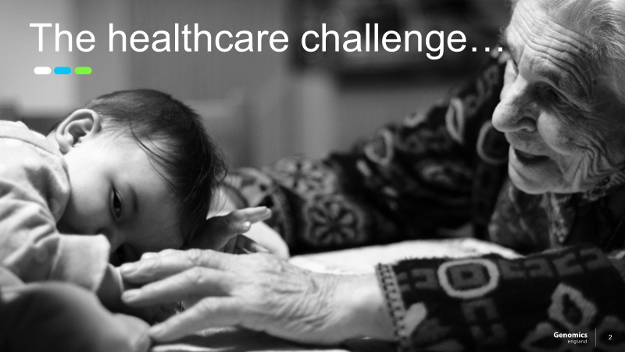
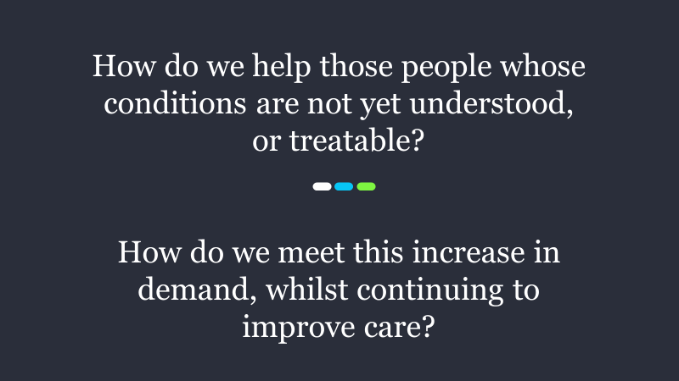
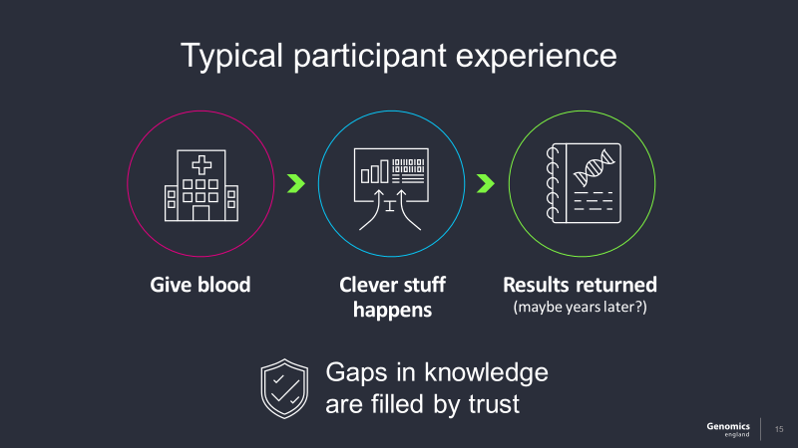
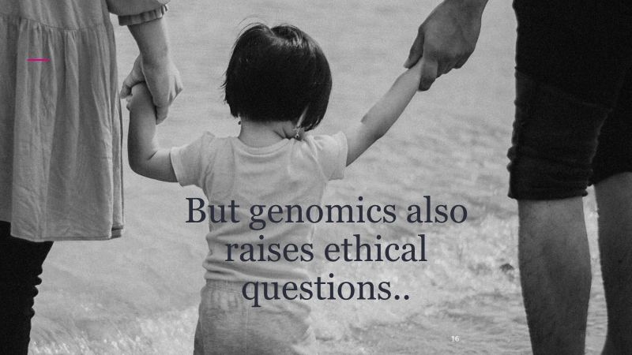

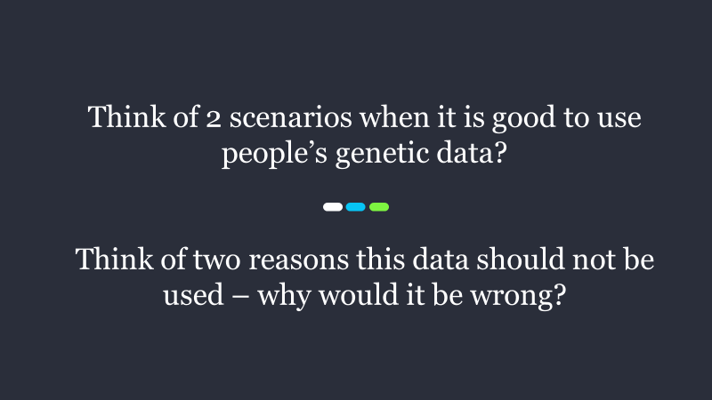
Theme: Genomics
Content:
#NEFUTURES
What is the Healthcare challenge? What is Genomics? Why is genomics important and what can it achieve? What influences Genomics use?
Challenges and Opportunities
Guest Speakers:
Simon Wilde
Engagement Director
Genomics England
What should be considered when using Genomics?
Notes:
Imagine you’re getting your first pair of glasses. Your eyesight has been changing slowly – too slowly for you to really notice what’s happening – and then you put that first pair on, and suddenly reading the menu at a coffee shop or the whiteboard at school is easy. When you go outside, every leaf on every tree is sharp and in focus. You can see details around you that you hadn’t even known you were missing.
For a lot of businesses, last year was like that new pair of glasses. The pandemic was a moment of truth, forcing enterprises to look at themselves through a different lens. It tested businesses in unexpected ways, it raised the bar for how adaptable and how innovative they needed to be, and it revealed vulnerabilities they had largely been able to ignore before. From inflexible work arrangements, to fragile supply chains, to untrustworthy information, COVID-19 showed businesses the limitations of how they have been operating.
And in response, businesses across every industry have begun a journey to reinvention. They dramatically accelerated their digital transformation timelines, compressing plans for the next decade into the next two or three years. To keep employees working and meet rapidly changing customer needs, they pivoted faster than many previously thought they could.
In just a few weeks at the beginning of the pandemic, the UK’s National Health Service rolled Microsoft Teams out to 1.2 million employees.
When fewer customers could go for test drives, Ford created 10 interactive augmented reality videos for its new electric Mustang Mach-E, so people could get a true feel for the car remotely.
The Geisinger Health System accelerated its investments in API modernization and microservices, gaining the agility and scalability they needed to seamlessly move to remote visits, double their remote workforce, and build a digital screening system and dashboard to let administrators do things like view real-time patient population data, reduce waits, and ensure social distancing.
So, after a year of rapid transformation, what are we left with?

Slide 16
Enrichment Session
Wed 20th October, 2021
#NEFUTURES
Week 6 - Convergence
Notes:
Imagine you’re getting your first pair of glasses. Your eyesight has been changing slowly – too slowly for you to really notice what’s happening – and then you put that first pair on, and suddenly reading the menu at a coffee shop or the whiteboard at school is easy. When you go outside, every leaf on every tree is sharp and in focus. You can see details around you that you hadn’t even known you were missing.
For a lot of businesses, last year was like that new pair of glasses. The pandemic was a moment of truth, forcing enterprises to look at themselves through a different lens. It tested businesses in unexpected ways, it raised the bar for how adaptable and how innovative they needed to be, and it revealed vulnerabilities they had largely been able to ignore before. From inflexible work arrangements, to fragile supply chains, to untrustworthy information, COVID-19 showed businesses the limitations of how they have been operating.
And in response, businesses across every industry have begun a journey to reinvention. They dramatically accelerated their digital transformation timelines, compressing plans for the next decade into the next two or three years. To keep employees working and meet rapidly changing customer needs, they pivoted faster than many previously thought they could.
In just a few weeks at the beginning of the pandemic, the UK’s National Health Service rolled Microsoft Teams out to 1.2 million employees.
When fewer customers could go for test drives, Ford created 10 interactive augmented reality videos for its new electric Mustang Mach-E, so people could get a true feel for the car remotely.
The Geisinger Health System accelerated its investments in API modernization and microservices, gaining the agility and scalability they needed to seamlessly move to remote visits, double their remote workforce, and build a digital screening system and dashboard to let administrators do things like view real-time patient population data, reduce waits, and ensure social distancing.
So, after a year of rapid transformation, what are we left with?

Slide 17

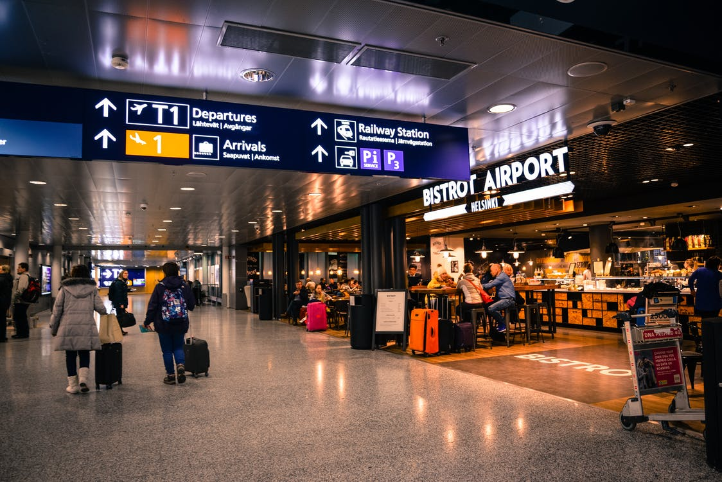
Theme: Convergence
Content:
#NEFUTURES
What is Convergence in technology? How would you prioritise investment projects in Newcastle? What technology could help? What new project ideas do you have?
What is Convergence?
Phone + Email + Camera + Diary + Clock
+ Translator + Book + Tickets + Credit Card
+ Map + Games + Translator + GPRS Beacon
Airport + Retail + Hotel + Bureau De Change + Restaurant + Car Hire + Rail Station + Loyalty Club
Guest Speakers:
Mark Larsen
Former Global Lead for Technology, Public Service
Accenture
Making ‘Real Life’ Choices over Newcastle Projects:
Project | Description | Benefits | Risks | Cost | Priority (Y/N)? | Reason
Social Care | Improve social care for older generation | Reduced hospital / care home costs | High initial cost Very expensive | £50m
Metro | Upgrade Metro network | Shorter journey times, less cars on roads | Travel disruption, long delivery times | £80m
Hospital Efficiency | Improve RVI Hospital Efficiency | Shorter waiting lists, more patients treated | “Black hole” Expensive | £30m
Car Building | Expand Nissan production and links to Port of Tyne | Increased jobs, more exports | Narrow focus, Environment? | £30m
Wind Farm | Extend wind farm in North Sea and export electricity to other regions | More green energy | Some local resistance Long term return | £50m
Airport | Build additional runway to support extra trans-Atlantic / long haul flights | More jobs, more choice of destinations, tourism | Environment? | £50m
ETC…
Notes:
Imagine you’re getting your first pair of glasses. Your eyesight has been changing slowly – too slowly for you to really notice what’s happening – and then you put that first pair on, and suddenly reading the menu at a coffee shop or the whiteboard at school is easy. When you go outside, every leaf on every tree is sharp and in focus. You can see details around you that you hadn’t even known you were missing.
For a lot of businesses, last year was like that new pair of glasses. The pandemic was a moment of truth, forcing enterprises to look at themselves through a different lens. It tested businesses in unexpected ways, it raised the bar for how adaptable and how innovative they needed to be, and it revealed vulnerabilities they had largely been able to ignore before. From inflexible work arrangements, to fragile supply chains, to untrustworthy information, COVID-19 showed businesses the limitations of how they have been operating.
And in response, businesses across every industry have begun a journey to reinvention. They dramatically accelerated their digital transformation timelines, compressing plans for the next decade into the next two or three years. To keep employees working and meet rapidly changing customer needs, they pivoted faster than many previously thought they could.
In just a few weeks at the beginning of the pandemic, the UK’s National Health Service rolled Microsoft Teams out to 1.2 million employees.
When fewer customers could go for test drives, Ford created 10 interactive augmented reality videos for its new electric Mustang Mach-E, so people could get a true feel for the car remotely.
The Geisinger Health System accelerated its investments in API modernization and microservices, gaining the agility and scalability they needed to seamlessly move to remote visits, double their remote workforce, and build a digital screening system and dashboard to let administrators do things like view real-time patient population data, reduce waits, and ensure social distancing.
So, after a year of rapid transformation, what are we left with?

Slide 18
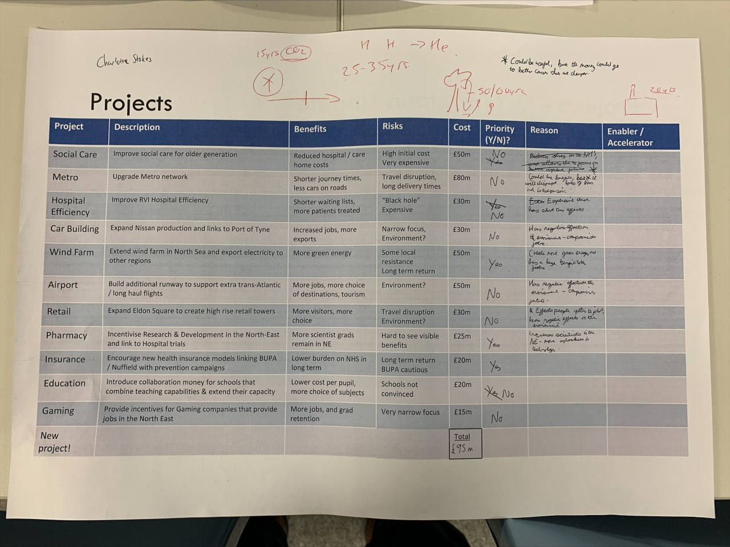
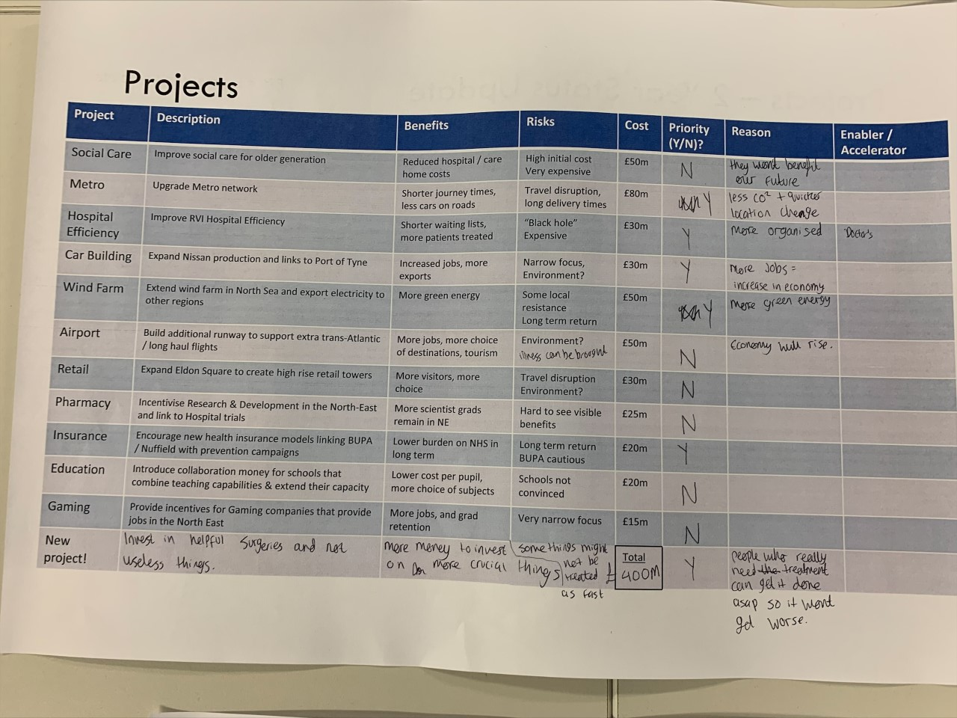
Student work

